Slide 1
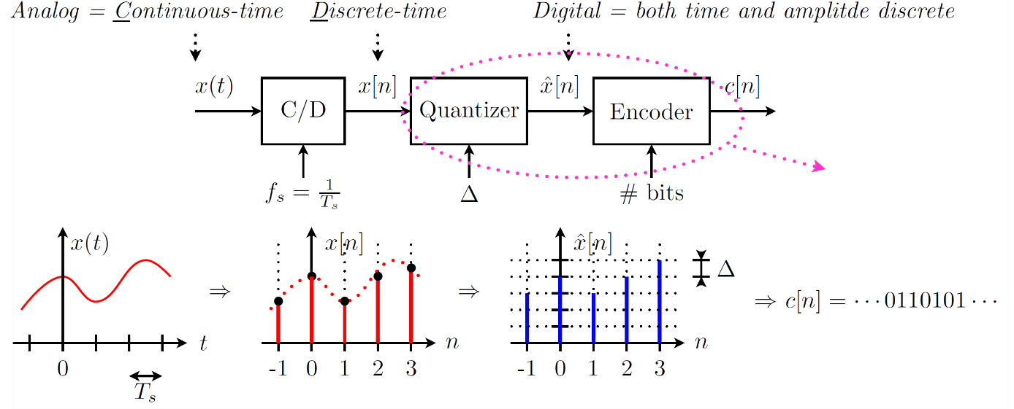
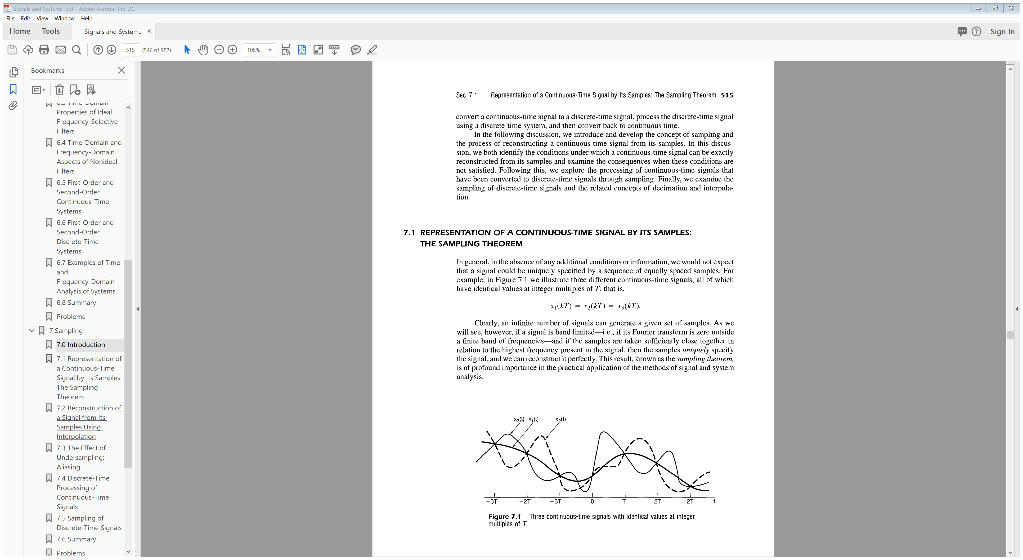
Chapter 7:Sampling

Slide 2
Contents
C/D conversion
D/C conversion
Processing analog signal with discrete-time filter
Sample rate conversion

Slide 3
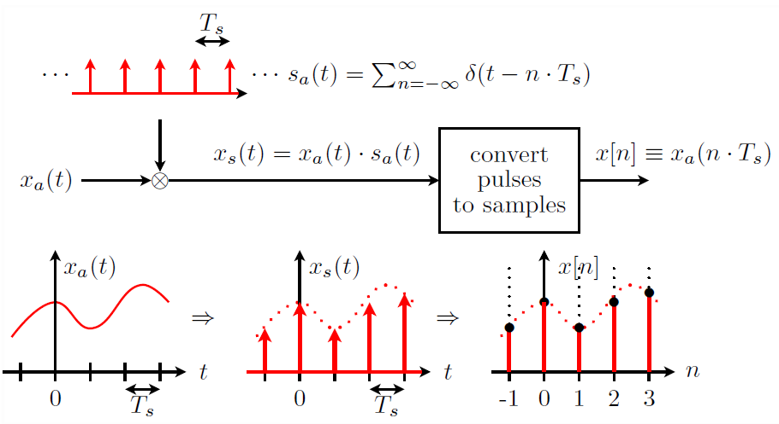




C/D conversion
Impulse-train sampling
$$x\left(t\right) δ\left(t−t_{0}\right)=x\left(t_{0}\right)δ\left(t−t_{0}\right)$$
sampling period
$ω_{s}=2π/T_{s}:$ sampling frequency
sampling function
$p\left(t\right)$ in the book
$x_{p}\left(t\right)$ in the book
$x\left(t\right)$ in the book

Slide 4
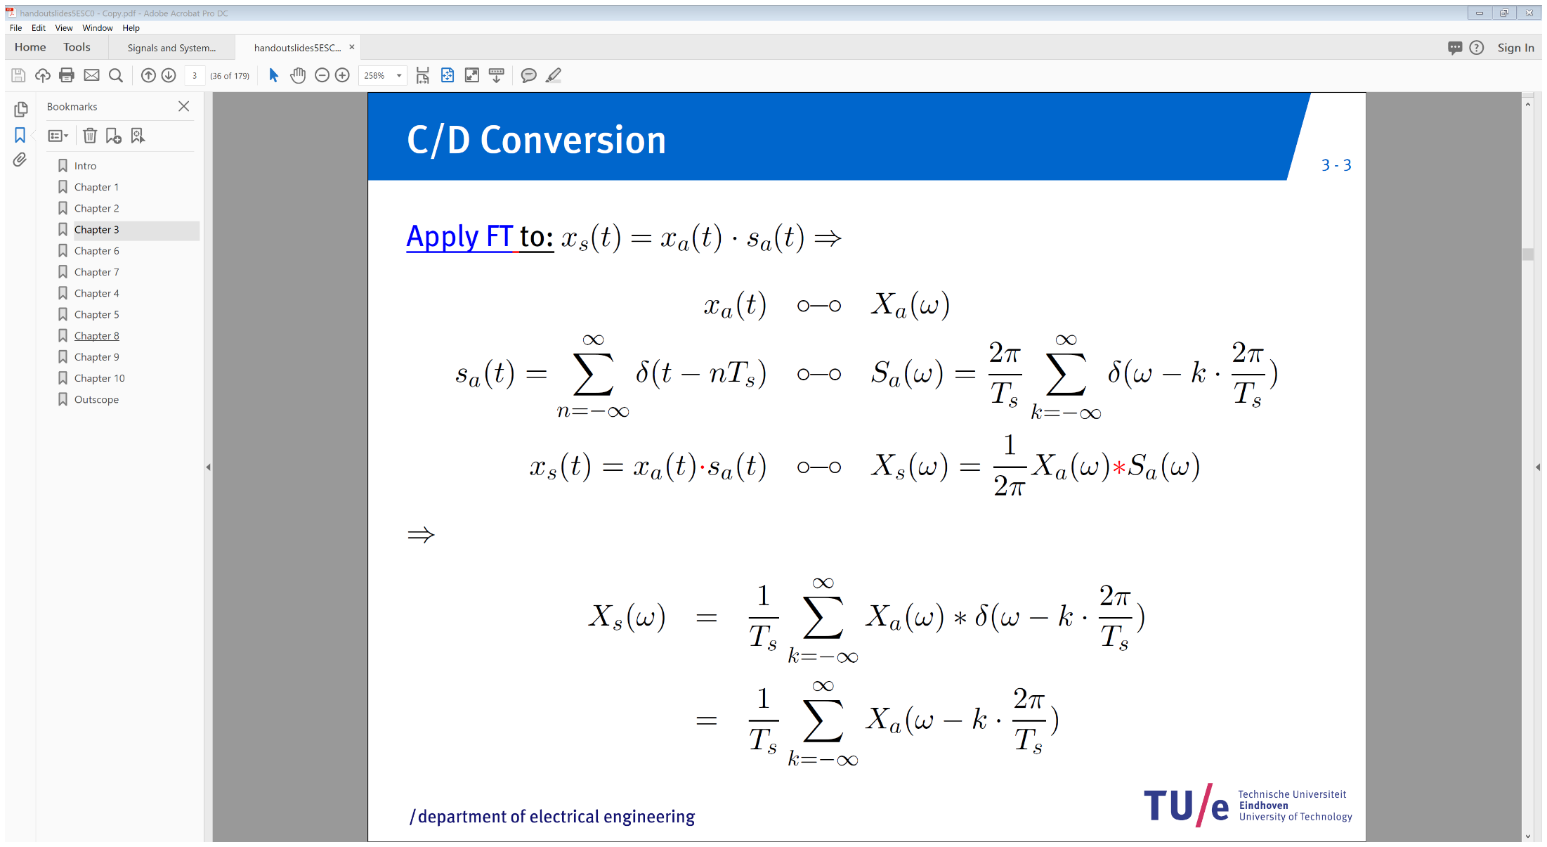
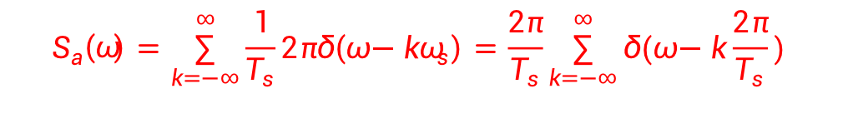
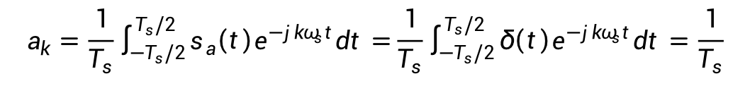


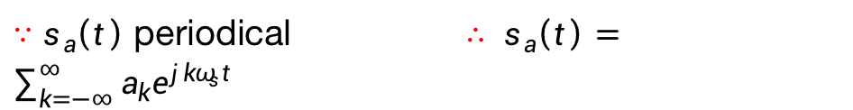
C/D conversion
Proof:
$∵s_{a}\left(t\right)$ periodical $∴ s_{a}\left(t\right)=\sum_{k=−∞}^{∞}{a_{k}e^{jkω_{s}t}}$
$${1∙e}^{jkω_{s}t}$$
$$2πδ(ω−{kω}_{s})$$
$$a_{k}=\frac{1}{T_{s}}\int_{−T_{s}/2}^{T_{s}/2}{s_{a}\left(t\right)e^{−jkω_{s}t}dt=}\frac{1}{T_{s}}\int_{−T_{s}/2}^{T_{s}/2}{δ\left(t\right)e^{−jkω_{s}t}dt=\frac{1}{T_{s}}}$$
$$S_{a}\left(ω\right)=\sum_{k=−∞}^{∞}{\frac{1}{T_{s}}2πδ\left(ω−{kω}_{s}\right)=\frac{2π}{T_{s}}\sum_{k=−∞}^{∞}{δ(ω−k\frac{2π}{T_{s}}) }}$$

Slide 5
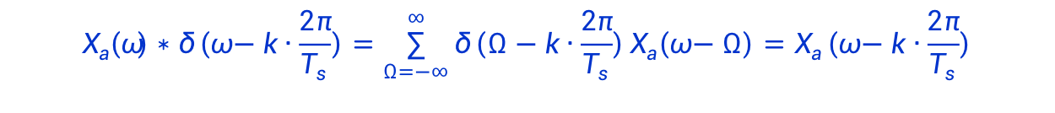
C/D conversion
$$X_{a}\left(ω\right)∗δ\left(ω−k∙\frac{2π}{T_{s}}\right)=\sum_{Ω=−∞}^{∞}{{δ\left(Ω−k∙\frac{2π}{T_{s}}\right)X}_{a}\left(ω−Ω\right)=X_{a}\left(ω−k∙\frac{2π}{T_{s}}\right)}$$

Slide 6
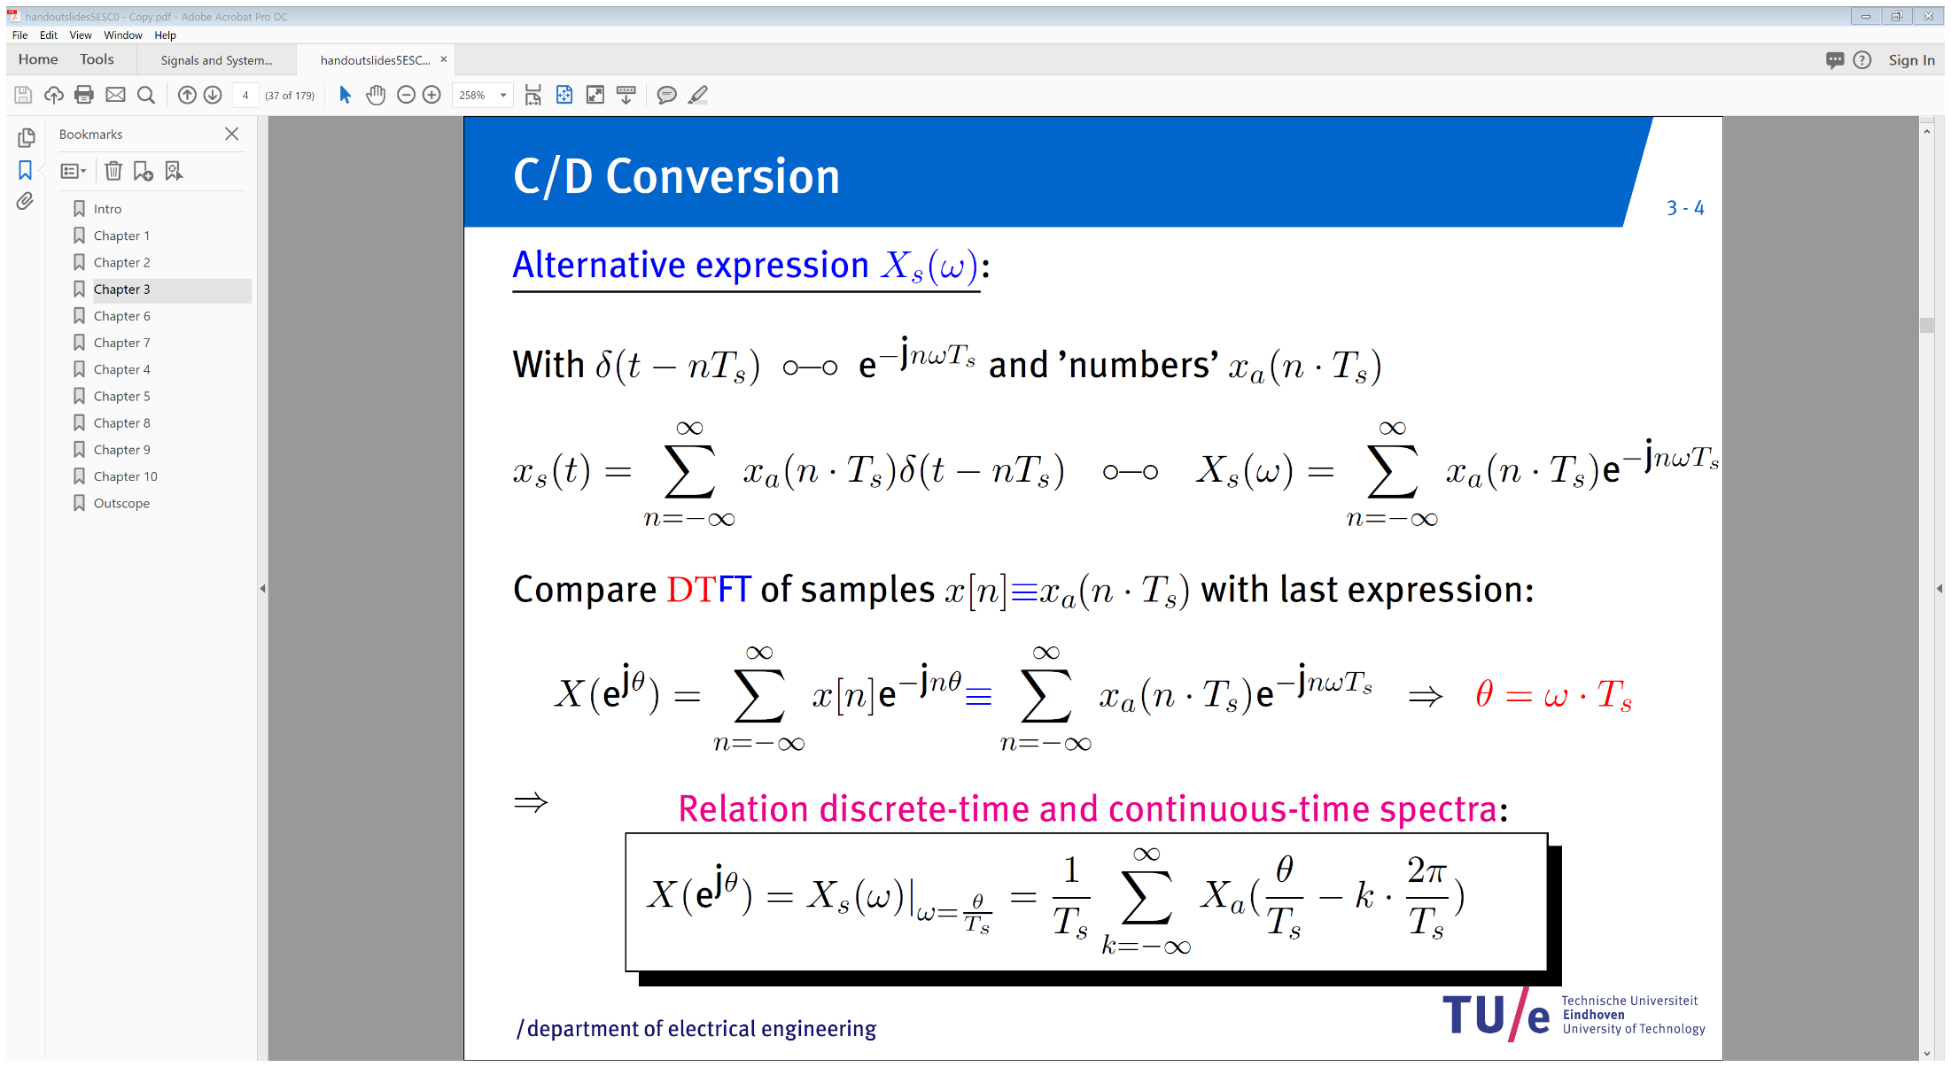
C/D conversion

Slide 7
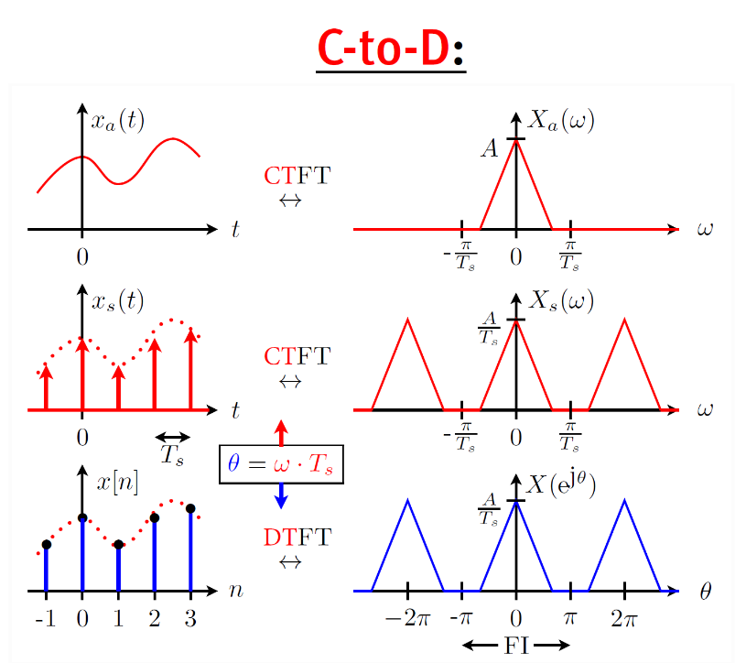
C/D conversion

Slide 8
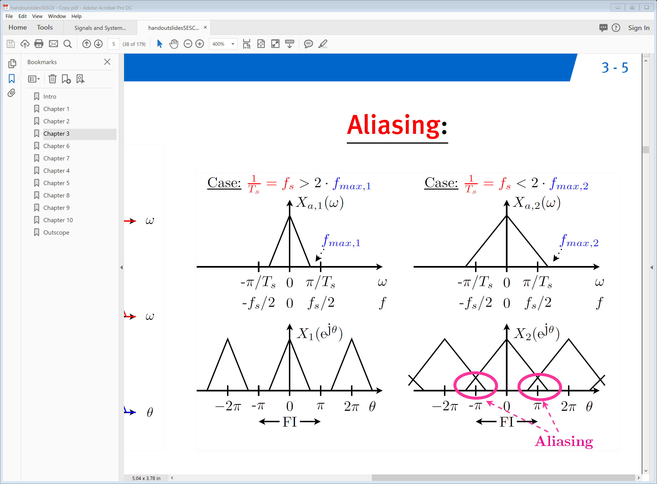
C/D conversion

Slide 9
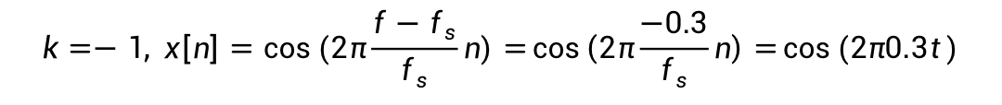
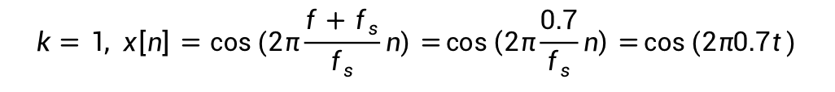

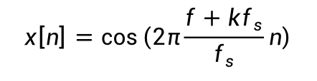
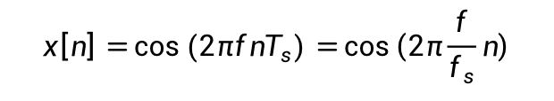
C/D conversion
example
$x_{c}\left(t\right)=\cos{(2πft)} with f=0.2 [Hz]$ is sampled with $f_{s}=0.5 \left[Hz\right],$
$$x\left[n\right]=\cos\left(2πfnT_{s}\right)=\cos\left(2π\frac{f}{f_{s}}n\right)$$
resulting in
$x_{c}\left(t\right)$ is not the only CT signal resulting in $x\left[n\right]!$
$$x\left[n\right]=\cos\left(2π\frac{f}{f_{s}}n\right)=\cos\left(2π\frac{f}{f_{s}}n+2kπ\right)=\cos\left(2π\frac{f}{f_{s}}n+2kπ∙n\right)$$
$$x\left[n\right]=cos\left(2π\frac{f+kf_{s}}{f_{s}}n\right)$$
for any integer $k$
$$k=1, x\left[n\right]=cos\left(2π\frac{f+f_{s}}{f_{s}}n\right)=\cos\left(2π\frac{0.7}{f_{s}}n\right)=\cos{(2π0.7t)}$$
$$k=−1, x\left[n\right]=cos\left(2π\frac{f−f_{s}}{f_{s}}n\right)=\cos\left(2π\frac{−0.3}{f_{s}}n\right)=\cos{(2π0.3t)}$$

